Slide 1
Small Business Entrepreneurship, and Franchises

Slide 2
Learning Objectives
5-1 Define what a small business is and recognize the fields in which small businesses are concentrated.
5-2 Identify the people who start small businesses and the reasons why some succeed and many fail.
5-3 Assess the contributions of small businesses to our economy.
5-4 Describe the advantages and disadvantages of operating a small business.
5-5 Explain how the Small Business Administration helps small businesses.
5-6 Explain the concept and types of franchising.
5-7 Analyze the growth of franchising and its advantages and disadvantages.

Slide 3
Small Business: A Profile
A small business is one that is independently owned and operated for profit and is not dominant in its field
99.7% of all employer firms
Employ about half of all private sector employees
Pay 42% of total U.S. private payroll
Have generated 63 percent of net new jobs over the past 20years
Hire 37% of high-tech workers
Are 52% home-based and 2% franchises
Produce 16.5 times more patents per employee than large patenting firms
Notes:
Additional Resources
Website
Wall Street Journal
Small Business
http://online.wsj.com/public/page/small-business.html?mg=reno64-wsj

Slide 4
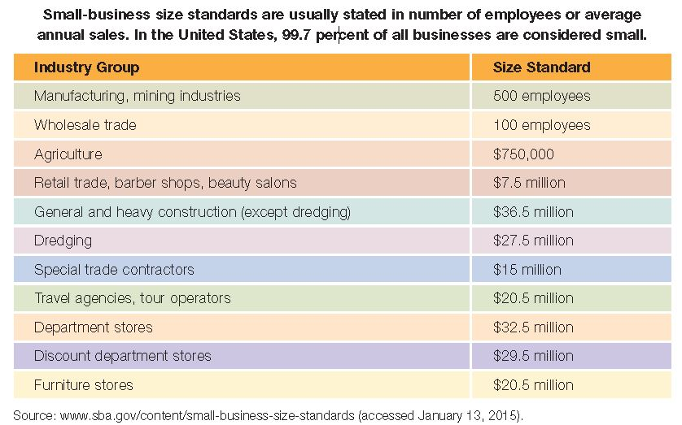
Small Business:
Industry Group-Size Standards
Notes:
Source: www.sba.gov/content/summary-size-standards-industry
Additional Resources
Article
CNN
Fact Check: Is Donald Trump a Small Business?
10/5/12
http://www.cnn.com/2012/10/04/politics/fact-check-trump-small-business/index.html

Slide 5
Small-Business Sector
It typically takes less than a week and $600 to establish a business as a legal entity
About 28.2 million businesses in this country
During the last decade, the number of small businesses in the United States has increased 49%
According to a recent study:
  69% of new businesses survive at least two years
  About 50% survive at least five years
  31% survive at least ten years

Slide 6
Industries That Attract Small Businesses
Industries that require only a low initial investment and some special skills or knowledge tend to attract new businesses
Knowledgeable entrepreneurs choose areas with which they are familiar, and these are most often the more established industries
Businesses generally fall into three broad categories of industry:
  Distribution
  Service
  Production

Slide 7

The People in Small Businesses:
The Entrepreneurs
Entrepreneurial spirit is the desire to create new business
Consider:
What are some reasons people want to start
their own businesses?
Notes:
Additional Resources
Website
Entrepreneur
http://www.entrepreneur.com/

Slide 8
Personal Factors and Motivation
Personal factors in small-business success:
  Independence
  A desire to determine one’s own destiny
  A willingness to find and accept a challenge
  Family background
  Age
Motivation to start a business:
  Person decides they have “had enough” or working and earning profit for others
  Person may lose his or her job
  Person has an idea for a new product
  An opportunity presents itself

Slide 9
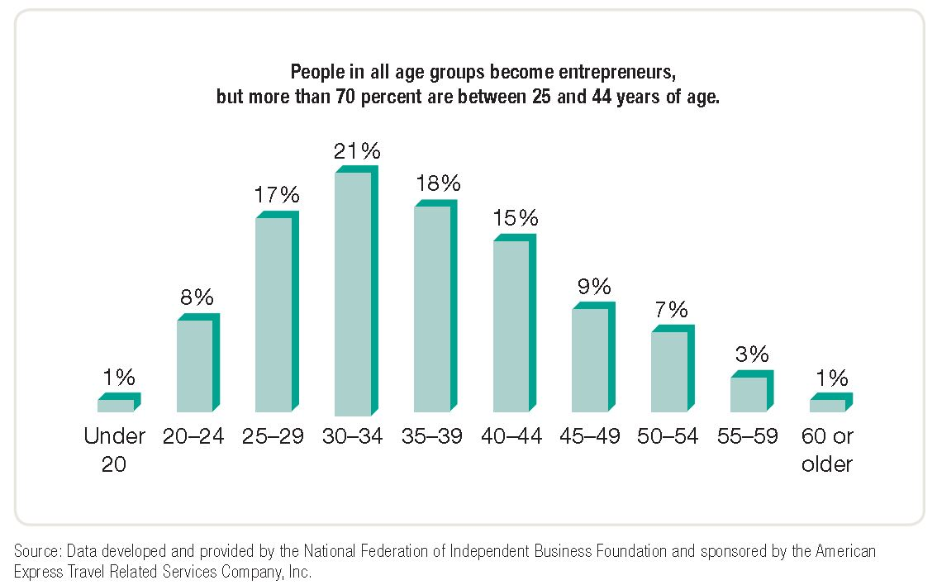
Average Age of Entrepreneurs
Notes:
Additional Resources
Website
Crain's: New York Business
40 Under 40
http://mycrains.crainsnewyork.com/40under40/

Slide 10
Women as Small-Business Owners
Own 36% of all small businesses
Own 66% of home-based businesses
Own about 7.8 million businesses
Provide 7.6 million jobs
Generate $1.2 trillion in sales
More than 40% have been in business 12 years or more
Businesses are financially sound and credit-worthy, and their risk of failure is lower than average
Compared to other working women, self-employed women are older, better educated, and have more managerial experience

Slide 11
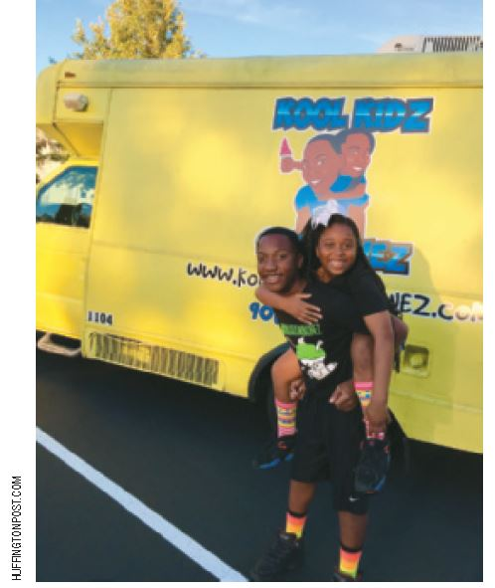
Teenage Entrepreneurs
Consider:
What challenges do teenage entrepreneurs face?
Consider:
Do teenagers
have any advantages?
Kool Kidz Sno Konez started by Amaya Selmon and Jaden Wheeler at ages 11 and 12 years old
Notes:
Additional Resources
Article
Business Insider
These 10 Pre-teen Entrepreneurs Make Millions More Than Their Parents
9/27/10
http://www.businessinsider.com/these-pre-teen-entrepreneurs-make-millions-more-than-their-parents-2010-9?op=1
Website
Under30CEO.com
http://under30ceo.com/30-most-influential-young-entrepreneurs-of-2011/
CNBC
20 Under 20
http://www.cnbc.com/id/45243912/
Slideshow
Teen Entrepreneurs
http://www.cnbc.com/id/48571760/Teen_Entrepreneurs

Slide 12
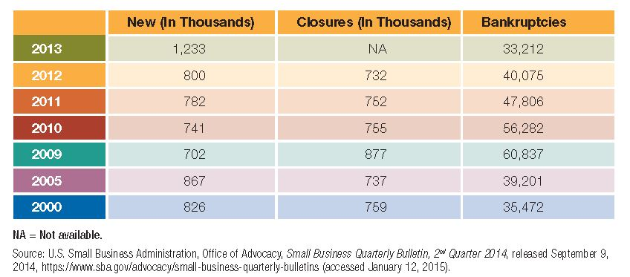
Why Some Entrepreneurs and Businesses Fail
Lack of capital and cash-flow problems
Lack of management skills
Overexpansion

Slide 13
Importance of Small Businesses:
Providing Technical Innovation
Small firms...
Employ 43% of all high-tech workers
Produce 2.5 times as many innovations as large firms relative to the number of persons employed
Produce 16 to 17 times more patents per employee than large patenting firms
According to the U.S. Office of Management and Budget, more than half the major technological advances of the 20th century originated with individual inventors and small companies

Slide 14
20th Century Innovations
Originated at Small Firms
Air-conditioning
Airplane
Automatic transmission
FM radio
Heart valve
Helicopter
Instant camera
Insulin
Jet engine
Penicillin
Personal computer
Power steering
© JULIAN ROVAGNATI/SHUTTERSTOCK

Slide 15
Importance of Small Businesses:
Providing Employment
Small firms...
Hire a larger proportion of younger and older workers, women, and part-time workers
Provide 67% of workers with their first job and initial job skills
Represent 99.7% of all employers and employ over 50% of the private work force
Provide 2/3 of the net new jobs added to the
economy

Slide 16
Importance of Small Businesses:
Providing Competition and Filling Needs
Providing Competition
  Small firms can compete with large firms, forcing the larger firm to become more efficient and responsive to customer needs
Filling Needs of Society and Other Businesses
  Small firms can meet the special needs of smaller groups of customers
  Small firms can act as specialized suppliers of goods and services to larger businesses

Slide 17

The Pros and Cons of Smallness
Advantages
Personal relationships with customers and employees
Ability to adapt to change
Simplified record keeping
Independence
Profit retention
Ease of start-up
Ability to keep secrets
Disadvantages
High risk of failure
Limited potential
Limited ability to raise capital

Slide 18
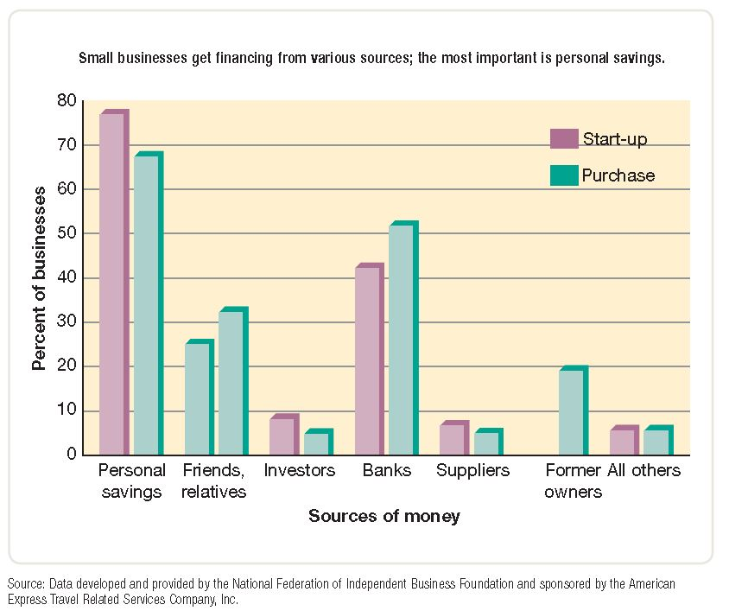
Sources of Capital for Entrepreneurs
Notes:
Source: Data developed and provided by the National Federation of Independent Business Foundation and sponsored by the American Express Travel Related Services Company, Inc.

Slide 19
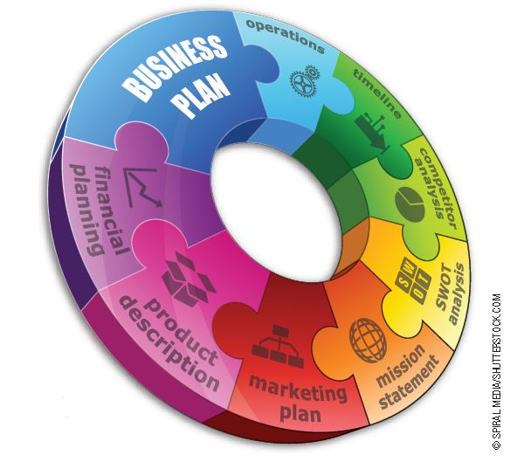
The Importance of a Business Plan
A business plan has three basic purposes:
  To communicate to potential investors
  To manage progress
  To plan the various phases of business
Should answer:
  What is the nature and
  mission of the new venture?
  Why is it a good idea?
  What are the goals?
  How much will it cost?
Notes:
Additional Resources
Website
SBA.gov
Create Your Business Plan
http://www.sba.gov/category/navigation-structure/starting-managing-business/starting-business/how-write-business-plan
Entrepreneur.com
Your Business Plan Guide
http://www.entrepreneur.com/businessplan/index.html

Slide 20
Components of a Business Plan
Introduction
Executive Summary
Benefits to the Community
Company and Industry
Management Team
Manufacturing and Operations Plan
Labor Force
Marketing Plan
Financial Plan
Exit Strategy
Critical Risks and Assumptions
Appendix
Notes:
Additional Resources
Sample business plans
http://www.entrepreneur.com/landing/216013
Several websites provide helpful information about writing a business plan.
http://www.sba.gov/
http://www.score.org
http://www.entrepreneur.com/businessplan/index.html

Slide 21
The Small Business Administration
The Small Business Administration (SBA) is a governmental agency that assists, counsels, and protects the interests of small business
in the United States
SBA management assistance includes:
  Management courses and workshops
  Service Corps of Retired Executives (SCORE): a group of more than 11,000 retired and active businesspeople, including more than 2,000 women who volunteer their services to small businesses through the SBA

Slide 22

SBA: Help for Minority-owned
Small Businesses
Small-business institutes (SBIs): groups of senior and graduate students in business administration who provide management counseling to small businesses
Small-business development centers (SBDCs): university-based groups that
provide individual counseling
and practical training to
owners of small businesses
SBA publications—SBA
issues management,
marketing, and technical
publications dealing with
hundreds of topics
berc/Fotolia

Slide 23
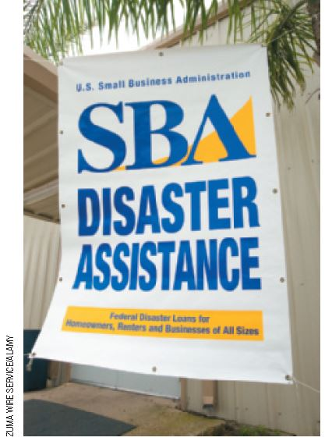
SBA: Financial Assistance
The SBA partially guarantees
regular business loans
  SBA will repay 90% of loan if
  the borrower cannot repay it
  Loans may be as large as
  $2 million
  Average loans are $300,000
  over eight years
The SBA licenses, regulates, and
provides financial assistance to
small-business investment companies (SBICs)
  SBICs: privately owned firms that provide venture
  capital to small enterprises that meet their investment standards
  Venture capital: money invested in small firms that have the potential to become very successful
Notes:
The Small Business Administration offers a wide variety of management and financial assistance to small businesses. It also offers a wealth of statistics about small business. For research and statistics related to small business, visit its website.
http://www.sba.gov/advocacy/847

Slide 24
Franchising
A franchise is a license to operate an individually owned business as though it were part of a chain of outlets or stores
  Franchising is the actual granting of a franchise
  A franchisor is an individual or organization granting a franchise
  A franchisee is a person or organization purchasing a franchise

Slide 25
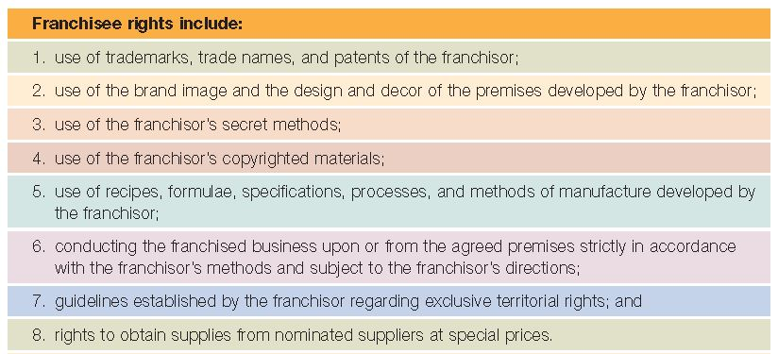
Franchise Rights
Source: Office of Entrepreneurship Education Resources, http://www.sba.gov/offices/headquarters/oee/resources/3641#Selecting a
Franchise (accessed January 12, 2015).

Slide 26
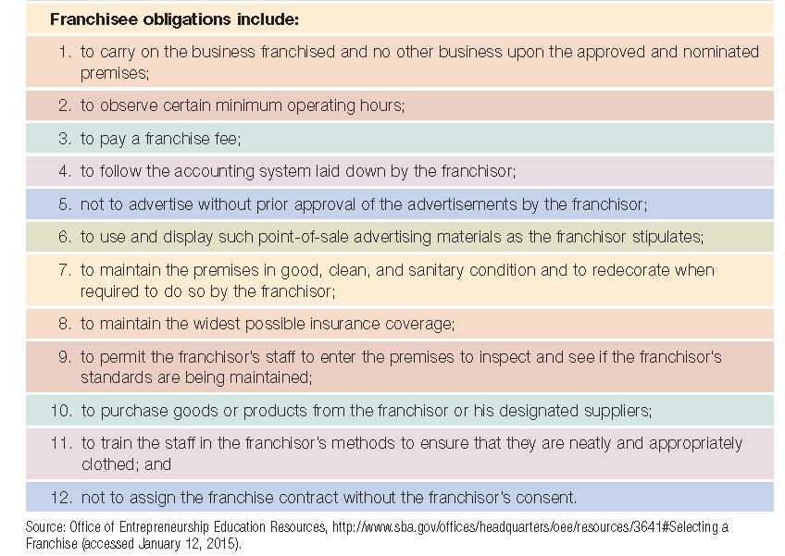
Franchise Obligations

Slide 27
Types of Franchising
A manufacturer authorizes retailers to sell a certain brand-name item
  One of the oldest forms
  Prevalent in sales of passenger cars and trucks, farm equipment, shows, paint, petroleum, etc.
A producer licenses distributors to sell a
product to retailers
  Common in the soft drink industry
A franchisor supplies brand names, techniques, or services instead of a complete product
  Primary role of franchisor is careful development and control of marketing strategies
  Most typical approach today

Slide 28
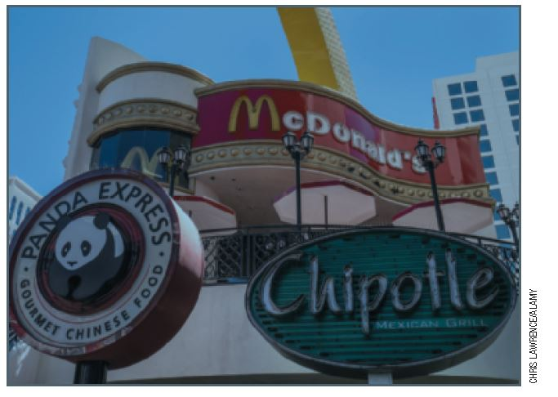
The Growth of Franchising
Franchising began in the United States around the time of the Civil War
Originally used by large firms to distribute products
Franchising has been increasing steadily in popularity since the early 1900s
Has experienced enormous
growth since the mid-1970s
Dual-branded franchises, in
which two franchisors offer
their products together, are
a new small-business trend
Notes:
Additional Resources
Restaurant News: Bruegger's franchisee co-brands units with Jamba Juice
8/16/12
http://nrn.com/article/brueggers-franchisee-co-brands-units-jamba-juice
MCB University Press: How Corporate Names Add Value
http://www.redaksjonen.com/Artikler/57Dualbranding.pdf
Ritchie International
Dual Branding – The New Franchise Phenomenon
http://www.google.com/url?sa=t&rct=j&q=&esrc=s&source=web&cd=1&cad=rja&ved=0CDMQFjAA&url=http%3A%2F%2Fwww.ritchieinternational.com%2FPressReleases35n45%2FDual%2520Branding%2520%2520The%2520New%2520Franchise%2520Phenomenon.doc&ei=VFejUO6zKPK30gGhz4CgCw&usg=AFQjCNEmuVWIuJ0_IBB5sWQxYhEDFHdu3w&sig2=VFyEZO9lkseB-fF0pJ3eaQ
Co-Branding – Here’s What You Have to Know
http://www.google.com/url?sa=t&rct=j&q=&esrc=s&source=web&cd=2&ved=0CDoQFjAB&url=http%3A%2F%2Fwww.ritchieinternational.com%2FPressReleases35n45%2FCo-Branding%2520Heres%2520What%2520You%2520Have%2520To%2520Know%2520to%2520Succeed.doc&ei=mVejUKuXIe7h0wHnwoGwCw&usg=AFQjCNEDdMlZpzDDaR5hVkGAtCdxf7lHhA&sig2=Fdq80AFnnRYJ7VMOAkbkfw

Slide 29
Are Franchises Successful?
The success rate for franchises is significantly higher than that for other small businesses
94% of franchise owners report that they are successful
Too rapid expansion, inadequate capital or management skills, or other problems can cause franchises to fail
“Despite the hype that franchising is the safest way to go when starting a new business, the research just doesn’t bear that out.”
—Timothy Bates, Wayne State University

Slide 30
Advantages of Franchising
To the Franchisor
  Fast and well controlled
  distribution of its products
  No need to construct and
  operate its own outlets
  More working capital
  available for expanded production and advertising
  Franchising agreements
  maintain product and quality standards
  Motivated work force of
  franchisees
To the Franchisee
  Opportunity to start a proven business with limited capital
  Guaranteed customers
  Franchisor available for advice and guidance
  Materials for local promotional campaigns and participation in national campaigns
  Cost savings when purchasing in cooperation with other franchisees

Slide 31
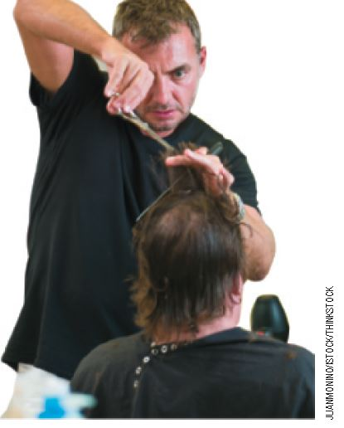
Disadvantages of Franchising
To the Franchiser
  Failure of the franchisee to operate franchise properly
  Disputes with and lawsuits by franchisees over the terms of the franchise
To the Franchisee
  Franchisor retains a large amount of control over the franchisee’s activities
  Franchisor opening competing franchises within the franchisee’s market

Slide 32
Global Perspectives in Small Business
National and international economies are growing more interdependent
Trade barriers are diminishing or disappearing
Globalization and instant worldwide communications are rapidly shrinking distances at the same time that they are expanding business opportunities
“More than 70 percent of the world’s purchasing power is outside of the United States and over the next five years, 85 percent of the world’s economic growth will be overseas.” —U.S. Commercial Service

Slide 33
Global Perspectives in Small Business:
Government Assistance
The SBA helps U.S. small business owners enter world markets
  Matches executives with potential overseas customers
  Helps exporters secure financing
  Brings small U.S. firms into direct communication with overseas buyers and partners
  SBA International Trade Loan guarantees up to $5 million in loans
The U.S. Commercial Service aids small and medium-sized businesses in selling overseas and has 251 offices in 76 countries
Notes:
Additional Resources
Report
The Dorrian Consulting Group
The Challenges Facing Small Business: A Global Perspective
http://www.dorriangroup.com/docs/NewsNov2005.pdf
Article
Framingham-based NANMAC Corporation Wins National SBA Small Business Exporter Award
http://www.mass.gov/export/news/press_nanmac.htm

Slide 34

Class Exercise
Consider:
Why do you think the Internet is cited as a favorite strategy for growth among small business owners?

